Slide 1
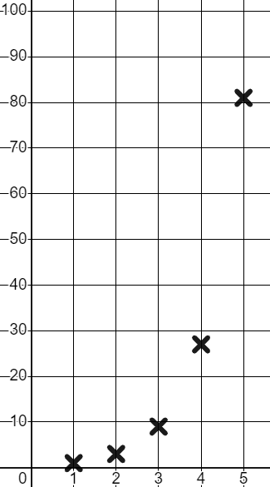
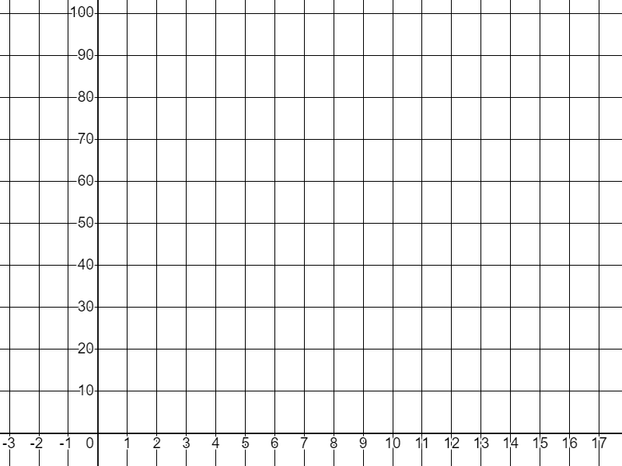
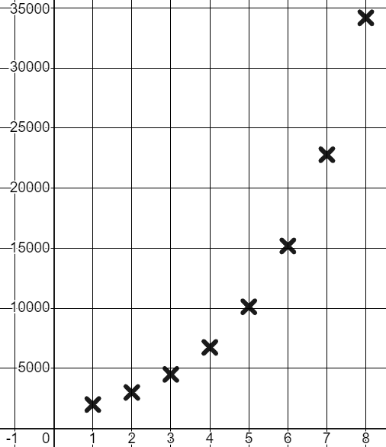
Representing geometric sequences graphically
Task A: Graphing a common ratio greater than 1
1) Fill in the table of values and plot the geometric sequence that starts on 1 and has a common ratio of 3
T
Term number (n) | 1 | 2 | 3 | 4 | 5
Term value (T) | 1 | 3 | 9 | 27 | 81
×3
×3
×3
×3
A line helps us to see the curve of a geometric sequence but, we don’t draw it.
n
2) You invest £2000 in a new tech company and your shares grow in value by 50% each year. Calculate their value for the first 8 years and plot it on the graph.
t | 1 | 2 | 3 | 4 | 5 | 6 | 7 | 8
£ | 2000 | 3000 | 4500 | 6750 | 10 125 | 15 188 | 22 781 | 34 172
×1.5
×1.5
×1.5
×1.5
×1.5
×1.5
×1.5
£
The points plot the curved pattern of a geometric sequence.
t

Slide 2

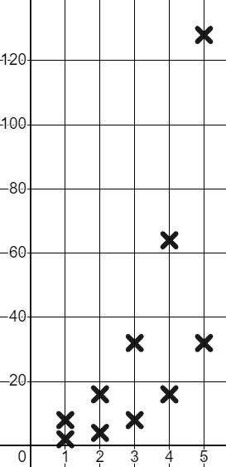

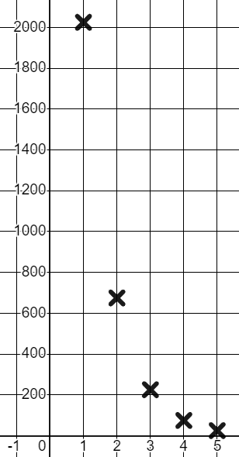


Representing geometric sequences graphically
3) Sam is contemplating the shape of the graphs of geometric sequences.
I don’t know if the starting term affects the shape. If I use the same common ratio of 2 but start on two different numbers will I get a different shape?
T
n | 1 | 2 | 3 | 4 | 5
T | 2 | 4 | 8 | 16 | 32
n | 1 | 2 | 3 | 4 | 5
T | 8 | 16 | 32 | 64 | 128
×2
×2
×2
×2
×2
×2
×2
×2
Using a common ratio to complete the tables, plot both graphs, and write a conclusion for Sam.
n
Both graphs have the same shape.
An upward curve getting increasingly more steep.
Task B: Graphing a common ratio less than 1
1) a) Complete the table of values and graph this geometric sequence with a common ratio
T
n | 1 | 2 | 3 | 4 | 5
T | 2025 | 675 | 225 | 75 | 25
Plot the coordinates as accurately as you can.
Common ratio between 0 and 1 giving us a downward curve.
n

Slide 3

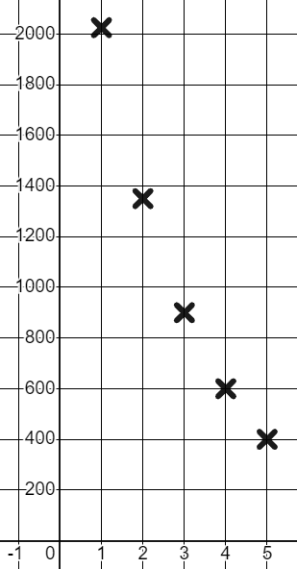

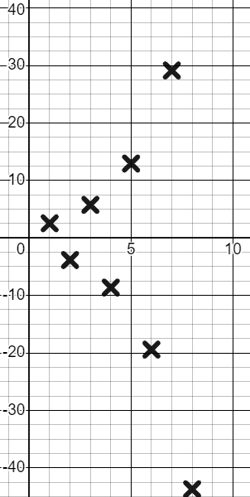
Representing geometric sequences graphically
1) b) Complete the table of values and graph this geometric sequence with a common ratio
T
n | 1 | 2 | 3 | 4 | 5
T | 2025 | 1350 | 900 | 600 | 400
Plot the coordinates as accurately as you can.
Common ratio between 0 and 1 giving us a downward curve slightly less steep than our curve.
n
2) Complete the table of values and graph this geometric sequence with a common ratio −1.5
T
n | 1 | 2 | 3 | 4 | 5 | 6 | 7 | 8
T | 2.56 | −3.84 | 5.76 | −8.64 | 12.96 | −19.44 | 29.16 | −43.74
×−1.5
×−1.5
×−1.5
×−1.5
×−1.5
×−1.5
×−1.5
n
Plot the coordinates as accurately as you can.
Negative common ratio giving us oscillating terms with the positive ones forming a curve and the negative ones forming a curve.
Mathematics in Education and Industry.

